Slide 1

Timber Tales
HOME FURNITURE

Slide 2

Company Profile
Certification: ISO 9001:2015 Certified
Specializations:
Web Development
Mobile Application Development
Custom Software Development
UI/UX Design
Hosting Services
Digital Marketing
Services:
Advanced IT solutions supporting the entire business
Consulting to system development
Deployment
Quality Assurance
24x7 Support
Headquarters: Jalandhar
Branch Office: Hoshiarpur

Slide 3
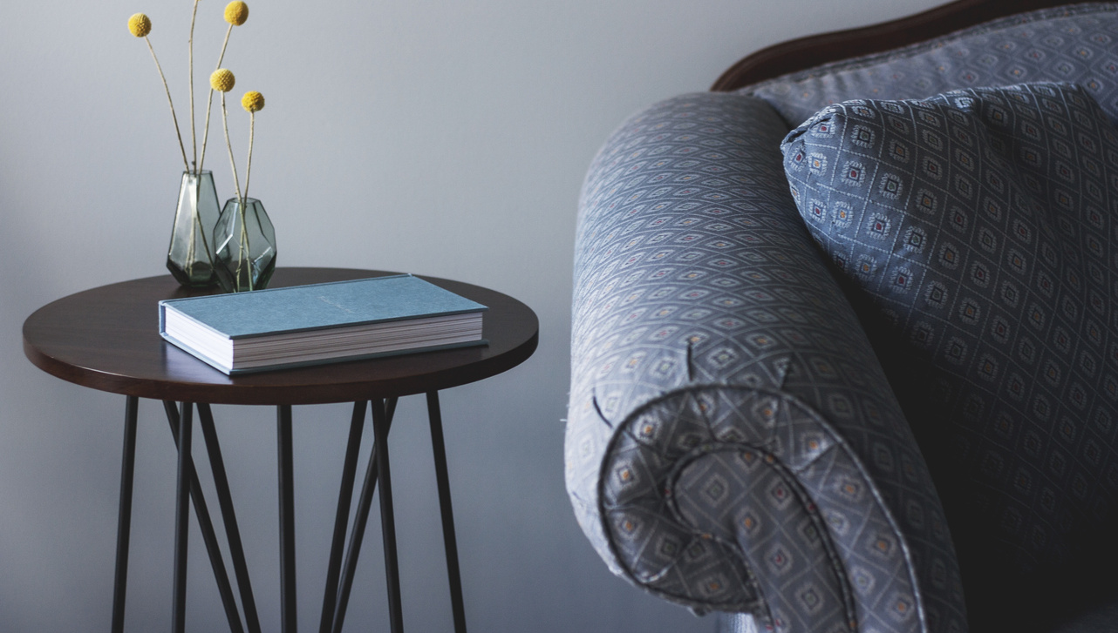
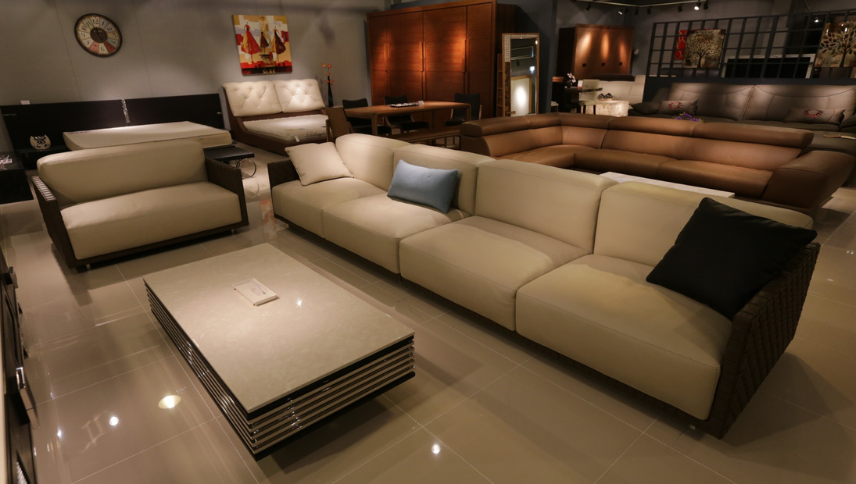
Table Of Contents
Drawback Of Existing System
Project Explanation
Modules
Advantages
DFD’s
Technology Used
Screenshot
Conclusion
Future Scope

Slide 4
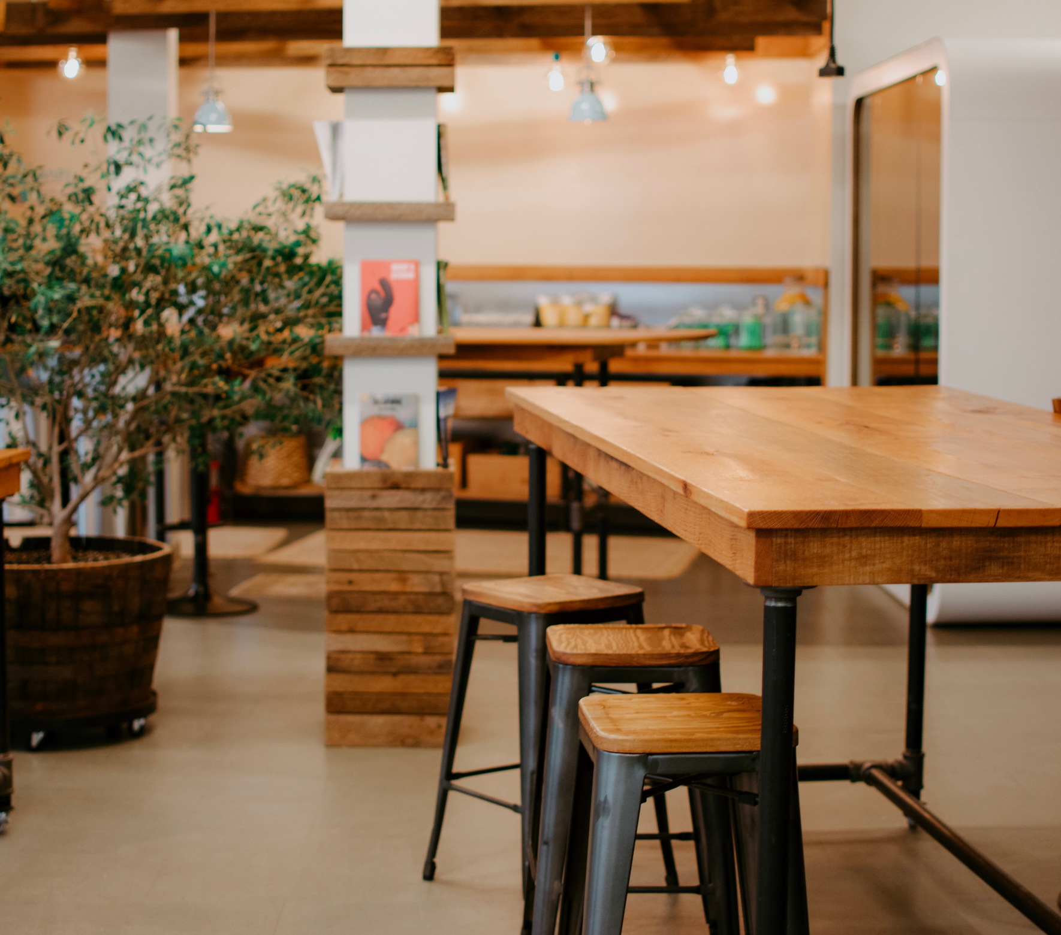
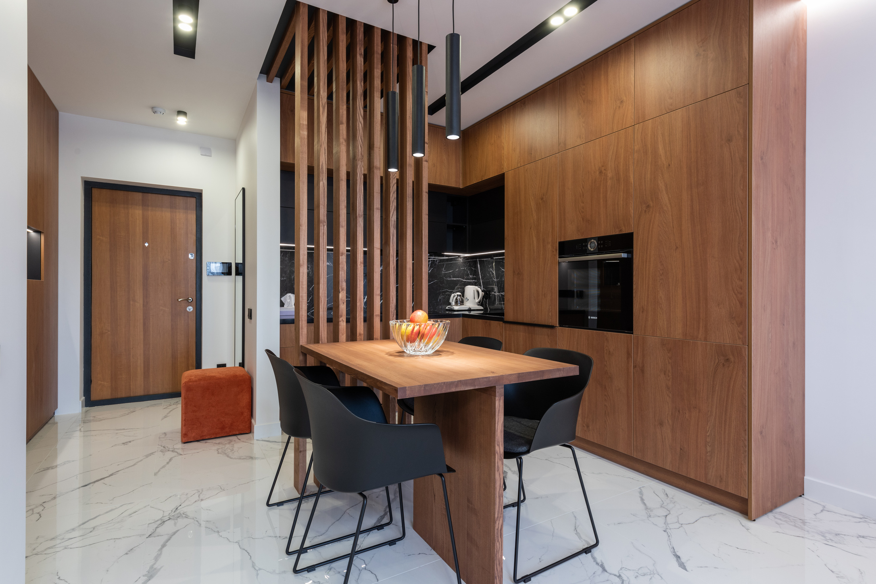
Drawback of Existing System
Lack of Data Sharing
Outdated Technology
Lack of storytelling integration

Slide 5
Develop an online platform specifically for timber works.
Facilitate real-time collaboration among customers.
Improve efficiency in timber construction processes.
Coordinate operations more effectively.
Project Explanation

Slide 6
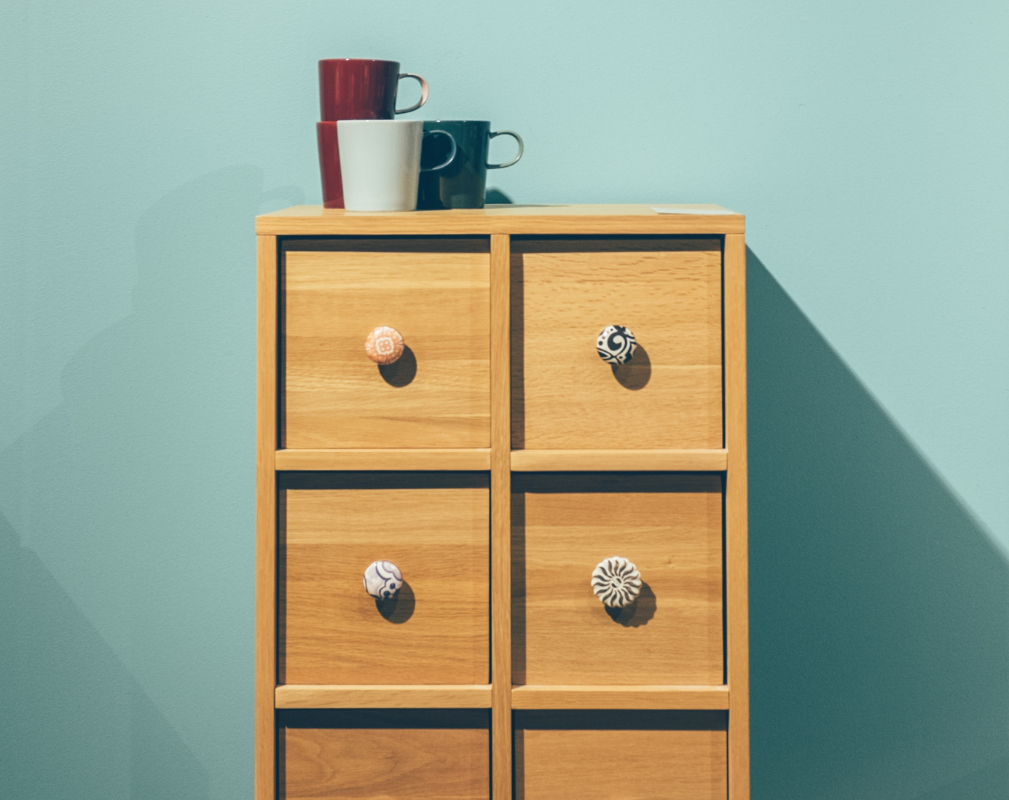
MODULES
ADMIN
CUSTOMER

Slide 7
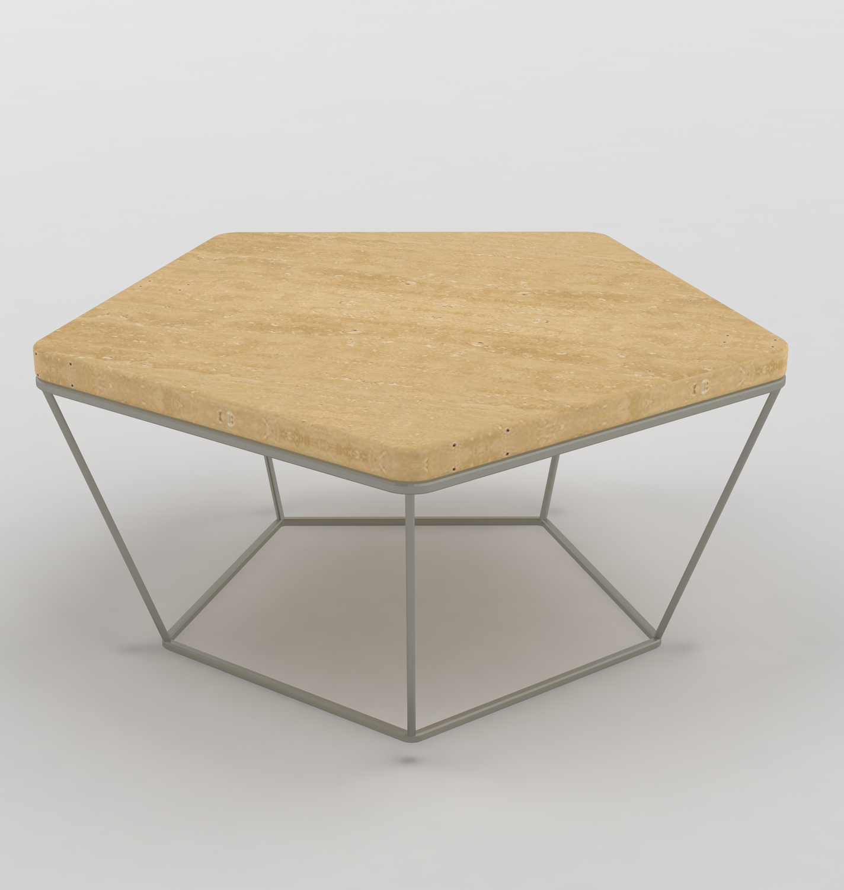
ADMIN
Login
View Customers
Add Designs
Update Designs
Add Bookings
Post Previous Work
Page 06
www.reallygreatsite.com

Slide 8
CUSTOMER
Login
Register
Manage Profile
View Designs
Add Bookings
View Previous Work
Page 06
www.reallygreatsite.com

Slide 9
ADVANTAGES
Efficiency and Productivity
Accessibility
Real-Time Collaboration
Centralized Data Management

Slide 10
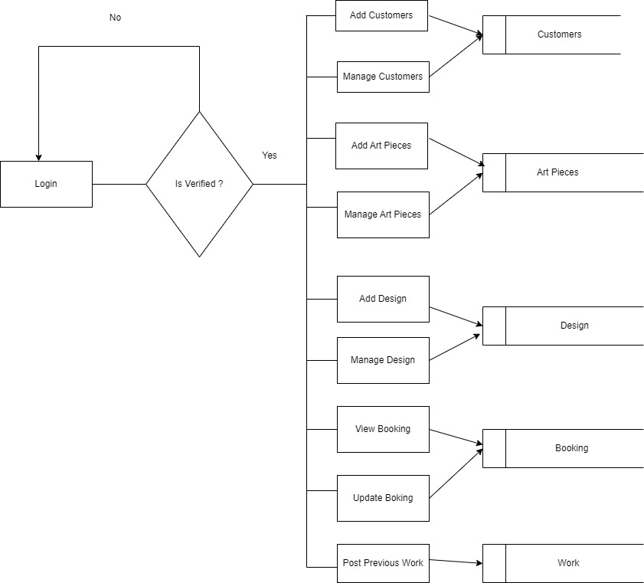
ADMIN [DFD]

Slide 11
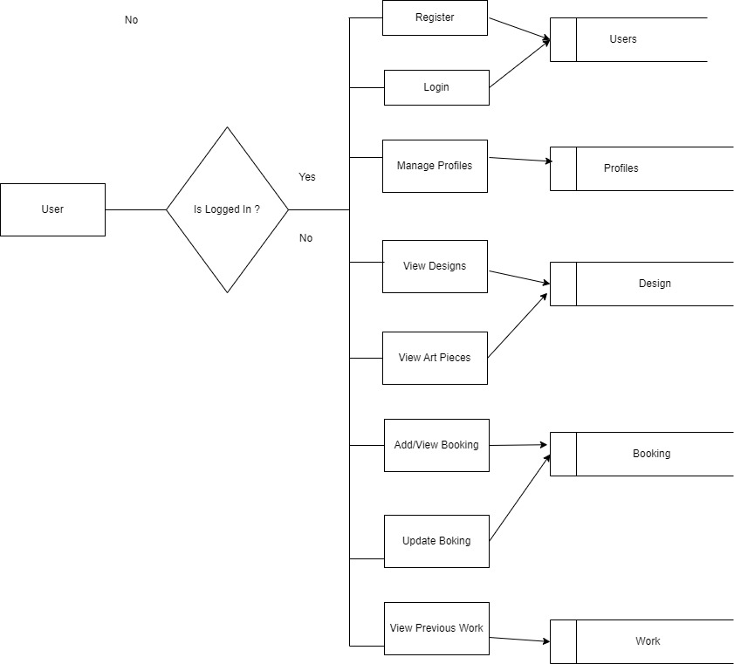
CUSTOMER [DFD]

Slide 12
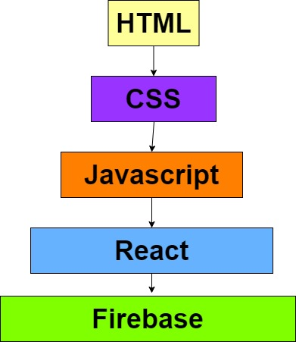
TECHNOLOGY USED
SALFORD & CO.
Page 09
High Quality
Great Design
Nice Decoration

Slide 13
CONCLUSION
SALFORD & CO.
Page 09
Advancement in Timber Industry
Real-Time Collaboration
Enhanced Efficiency in Construction
Data Management
High Quality
Great Design
Nice Decoration

Slide 14
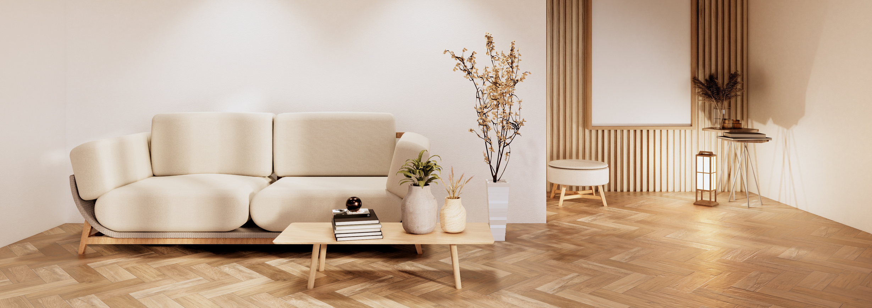



Future Scope
Global E-commerce Reach
Artisanal Craftsmanship Showcase
Customization Options

Slide 15


